Slide 1
Deep Learning Based Suspicious Behaviour Analysis From Surveillance Video
MCA
2019202026
Karthicksankar K
Guide Name
Dr. P Geetha

Slide 2


Slide 3
Problem Statement
The problem statement was CCTV help to find the criminal but not earlier the suspicious activity occurs.
Existing system stores the data in form of records only and needed continuous monitoring which is labor intensive task.

Slide 4
Abstract
In the system, we can detect particular video coverage of human suspicious behaviour and weapons.
To develop a model to detect the any suspect activity during its occurrence with the help of CCTV footage.
After detecting the suspicious activity, the system make alert to the security and also send message to Police control room(Crime branch).

Slide 5
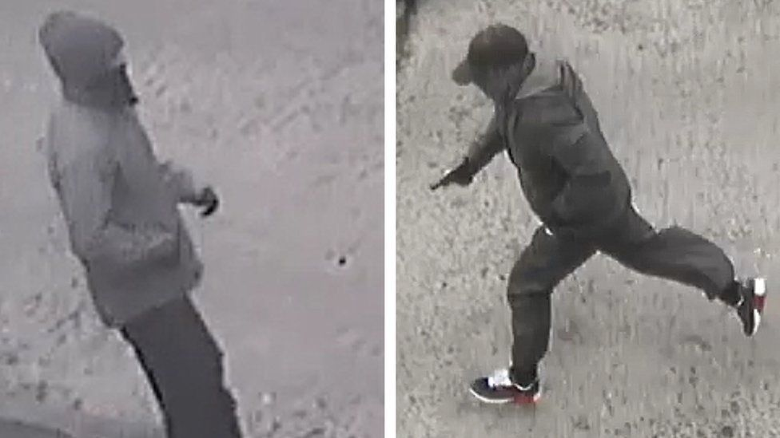

Normal Activity Suspicious Activity

Slide 6
Advantage
Detect the crime
Alert the security
Solve the crime cases in Police department

Slide 7
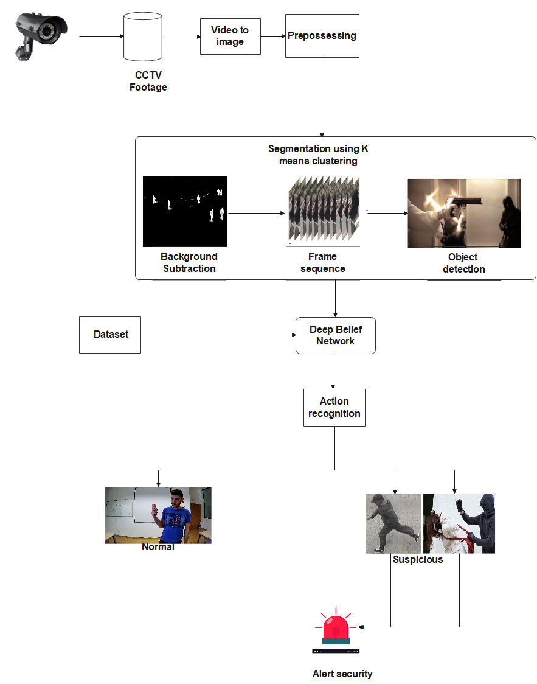

Slide 8
Deep Belief Network (DBN):
Deep Belief Network (DBN) is a generative graphical model, or alternatively a class of deep neural network, composed of multiple layers of latent variables ("hidden units"), with connections between the layers but not between units within each layer.
When trained on a set of examples without supervision, a DBN can learn to probabilistically reconstruct its inputs. The layers then act as feature detectors. After this learning step, a DBN can be further trained with supervision to perform classification.

Slide 9
MODULES
1. Video Acquisition
2. Pre-processing
3. Segmentation
4. Extraction
5. Action recognition

Slide 10
Technology
Development Platform: Matlab IDE
Language: Matlab
Dataset : Real life violence situations
Notes:
https://dasci.es/transferencia/open-data/24705/
https://www.kaggle.com/datasets/mohamedmustafa/real-life-violence-situations-dataset

Slide 11
References
Amrutha C.V, C. Jyotsna, Amudha J. “Deep Learning Approach for Suspicious Activity Detection from Surveillance Video” , IEEE Xplore , Issue 23 April 2020
Phalguni Kadam , Shweta Gawande , Akshita Thorat , Rohini Mule. “Suspicious Activity Detection using Image Processing”, Journal of Science and Technology , Issue 01, August 2021.
Notes:
https://ieeexplore.ieee.org/abstract/document/9074920
http://jst.org.in/wp-content/uploads/2021/08/Suspicious-Activity-Detection-using-Image-Processing.pdf

Slide 12
Con..
Dr. N. Geetha, Akash Kumar. K. S, Akshita. B. P, Arjun. M. “Weapon Detection in Surveillance System”, International Journal of Engineering Research & Technology (IJERT) -Issue 05, May-2021
Tejashri Subhash Bora , Monika Dhananjay Rokade. “HUMAN SUSPICIOUS ACTIVITY DETECTION SYSTEM USING CNN MODEL FOR VIDEO SURVEILLANCE”, IJARIIE , March 2020
Notes:
https://www.ijert.org/weapon-detection-in-surveillance-system
https://ijariie.com/AdminUploadPdf/HUMAN_SUSPICIOUS_ACTIVITY_DETECTION_SYSTEM_USING_CNN_MODEL_FOR_VIDEO_SURVEILLANCE_ijariie14261.pdf

Slide 13

5

